Slide 1
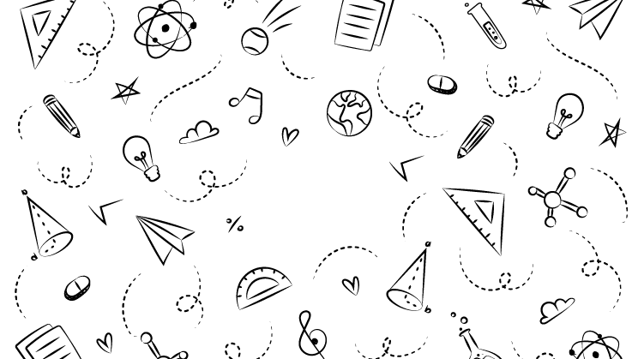



NEXT GEN EMPLOYABILITY PROGRAM
Creating a future-ready workforce
Team Members
College Name
Student Name :Mohanapriya.S
NM ID :au110321104029
Student ID:110321104029
Mail id:mohanapriyas144@gmail.com
1103-GRT Institute of engineering and technology

Slide 2

CAPSTONE PROJECT SHOWCASE
Project Title
MUSIC WEB APPLICATION USING DJANGO FRAMEWORK
Abstract | Problem Statement | Project Overview | Proposed Solution | Technology Used | Modelling & Results | Conclusion

Slide 3
Abstract
This project aims to develop a music web applicationts named Beats Buddy using the Django framework, which will provide users with a platform to discover, listen to, and manage their favorite music tracks. The technologies used are Front end:HTML,CSS,Javascript,Bootstrap, Back end:Python,Django framework and SQL.The application will feature a user-friendly interface where users can search for songs, create playlists, and interact with other music enthusiasts. In early days, for people to enjoy music, they had to buy/download songs only through few websites and listen only on the device they've downloaded on. Additionally, the application will leverage Django's built-in authentication system to allow users to create accounts, log in, and personalize their music experience. The use of Django's ORM (Object-Relational Mapping) will facilitate efficient data storage and retrieval, ensuring a seamless user experience. Overall, this project seeks to create a robust and engaging music application that showcases the capabilities of the Django framework in web development. Users can freely publish their music for public to enjoy. It is free to all communities and inclusive.
Source : https://www.cleveroad.com/blog/howto-create-a-music-streaming-app
https://www.resourceumc.org/en/cont
ent/5-steps-to-building-and-managinga-digital-music-library

Slide 4
Problem Statement
In today's digital age, music consumption has evolved, with more people relying on online platforms to discover and enjoy music. However, many existing music applications lack user-friendly interfaces and robust features, limiting the overall user experience. This project aims to address these limitations by developing a music web application using the Django framework. The application will provide users with a seamless platform to discover, listen to, and manage their favorite music tracks. By leveraging Django's powerful features, such as its ORM for efficient data storage and its built-in authentication system for user management, this project seeks to create a compelling music application that enhances the way users interact with music online. The world that we live in are often called “The busy world " because we see people around us always in a rush going to their offices, schools, colleges etc. Thankfully now, we have numerous music player applications where we can listen to collection of over millions of songs. But, there is a price to pay and we don't have the freedom to download them onto our devices to stream our songs without internet.
Source : https://www.cleveroad.com/blog/howto-create-a-music-streaming-app
https://www.resourceumc.org/en/cont
ent/5-steps-to-building-and-managinga-digital-music-library

Slide 5
Project Overview
MusicHub is a web application that aims to provide users with a platform to discover, listen to, and manage their favorite music tracks. The application will feature a user-friendly interface with powerful search capabilities, allowing users to find songs, albums, and artists quickly
Create a user-friendly music streaming application.
Provide a seamless music discovery and listening experience.
Implement robust features for playlist management and social interaction.
Ensure scalability and performance for handling a large number of users and music content.
User Registration and Authentication: Users can create accounts, log in, and manage their profiles.
Music Library: Users can browse a vast library of songs, albums, and artists.
Search Functionality: Powerful search feature to find specific songs, albums, or artists.
Streaming: High-quality audio streaming for a seamless listening experience.
Responsive Design: The application will be responsive, ensuring a consistent experience across different devices.
Source : https://www.cleveroad.com/blog/howto-create-a-music-streaming-app
https://www.resourceumc.org/en/cont
ent/5-steps-to-building-and-managinga-digital-music-library

Slide 6
Proposed Solution
The proposed solution for the Music application named Beats Buddy project involves developing a Django-based web application with the following key components and functionalities:
User Authentication and Profile Management: Implement Django's built-in authentication system to allow users to create accounts, log in, and manage their profiles. Users can also update their preferences and settings.
Music Library: Develop a music library where users can browse songs, albums, and artists. Utilize Django's ORM to manage music data efficiently, including metadata such as song title, artist name, album name, and genre.
Search Functionality: Implement a powerful search feature that allows users to search for specific songs, albums, or artists. Use Django's queryset filtering capabilities to enhance search performance.
Social Features: Implement social features such as sharing music with friends, following other users, and discovering new music based on user preferences. Use Django's authentication system to manage user relationships and interactions.
.
Source : https://www.cleveroad.com/blog/howto-create-a-music-streaming-app
https://www.resourceumc.org/en/cont
ent/5-steps-to-building-and-managinga-digital-music-library

Slide 7
5.Playlist Management: Enable users to create, edit, and delete playlists. Utilize Django's relational database capabilities to associate playlists with users and songs.
6.Audio Streaming: Implement audio streaming functionality to enable users to listen to music directly on the platform. Use Django to handle file uploads and streaming capabilities.
7.Responsive Design: Ensure that the application is responsive and can adapt to different screen sizes and devices. Use HTML, CSS, and JavaScript to create a user-friendly interface.
8.API Development: Develop RESTful APIs using Django REST framework to enable communication between the frontend and backend. APIs will be used for features such as fetching music data, managing playlists, and user interactions.
9.Testing and Deployment: Conduct thorough testing of the application to ensure functionality and performance. Deploy the application to a production environment using tools like Heroku or AWS.
10.Documentation: Create comprehensive documentation for the application, including installation instructions, usage guidelines, and API documentation.
Overall, the proposed solution aims to deliver a robust and user-friendly music streaming application that leverages the Django framework's features and capabilities.10
Source : https://www.cleveroad.com/blog/howto-create-a-music-streaming-app
https://www.resourceumc.org/en/cont
ent/5-steps-to-building-and-managinga-digital-music-library

Slide 8
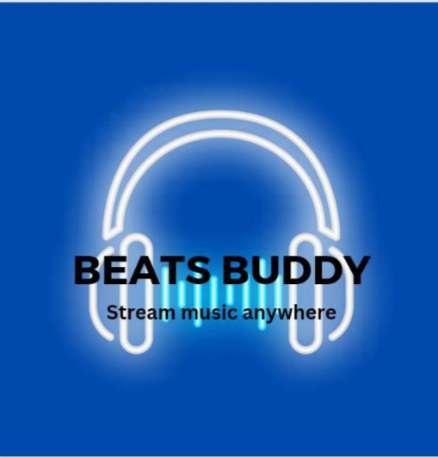
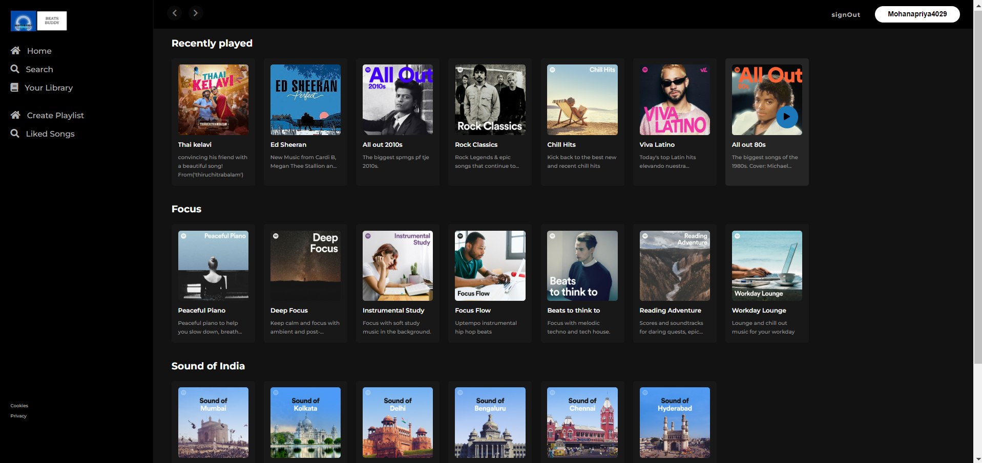

Slide 9


Technology Used
Front-end
Back-end

Slide 10
Modelling & Results
For the Music application named Beats Buddy project, the data model can be designed to include the following entities:
User
Song
Album
Playlist
User Playlist
Followers
Results of the modeling process could include:
1.Entity-Relationship Diagram (ERD).
2.Database Schema.
3.Data Migration.
4.Database Population.
The results of the modeling process will form the foundation of the Music application, providing the structure for storing and retrieving music-related data efficiently.
Source : https://www.cleveroad.com/blog/howto-create-a-music-streaming-app
https://www.resourceumc.org/en/cont
ent/5-steps-to-building-and-managinga-digital-music-library

Slide 11
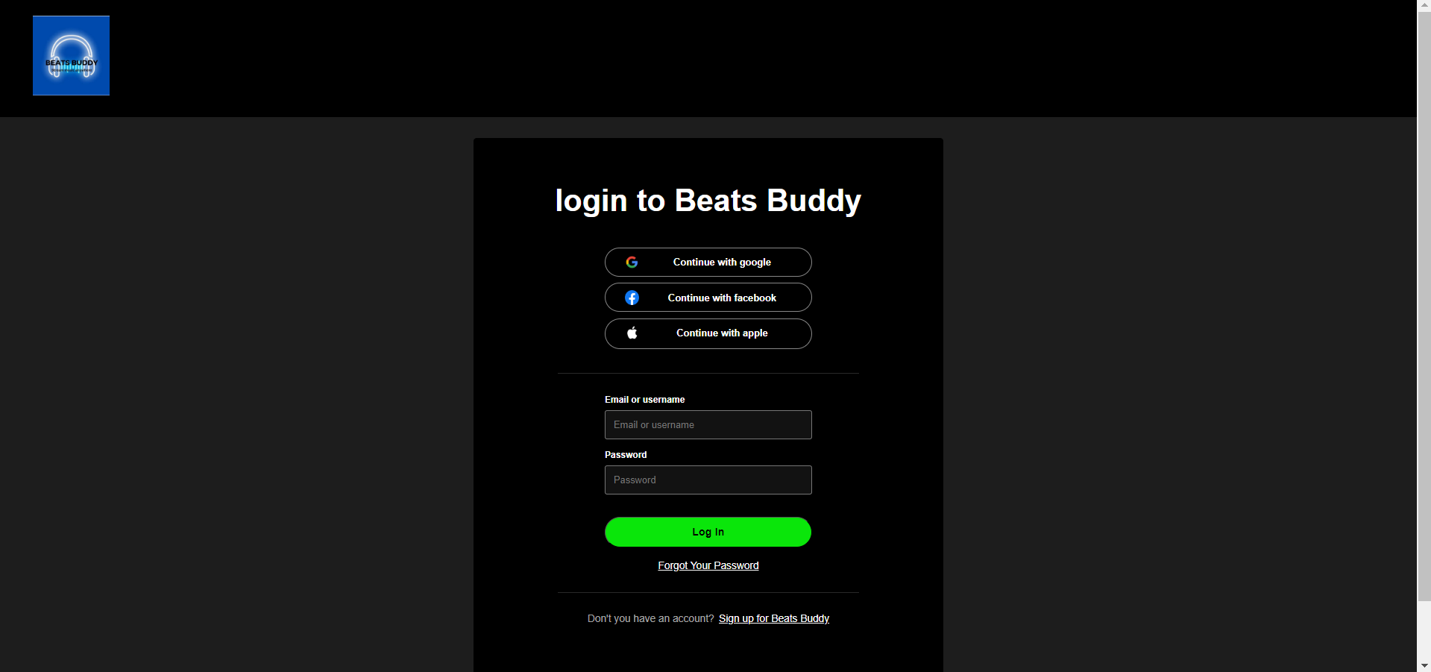
LOGIN PAGE

Slide 12
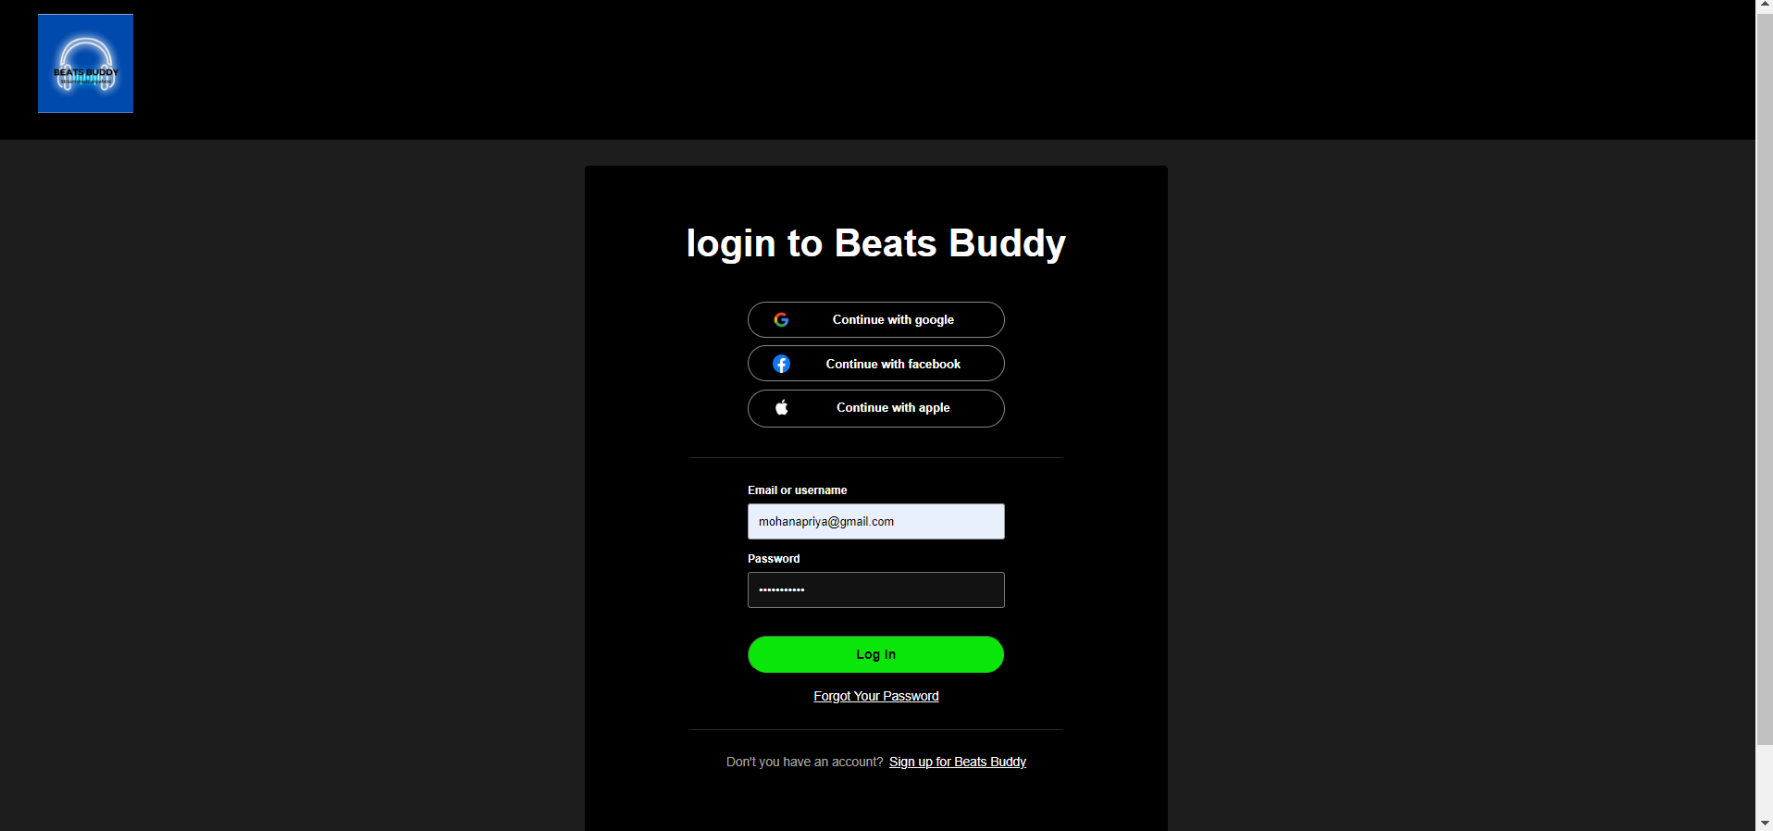

Slide 13
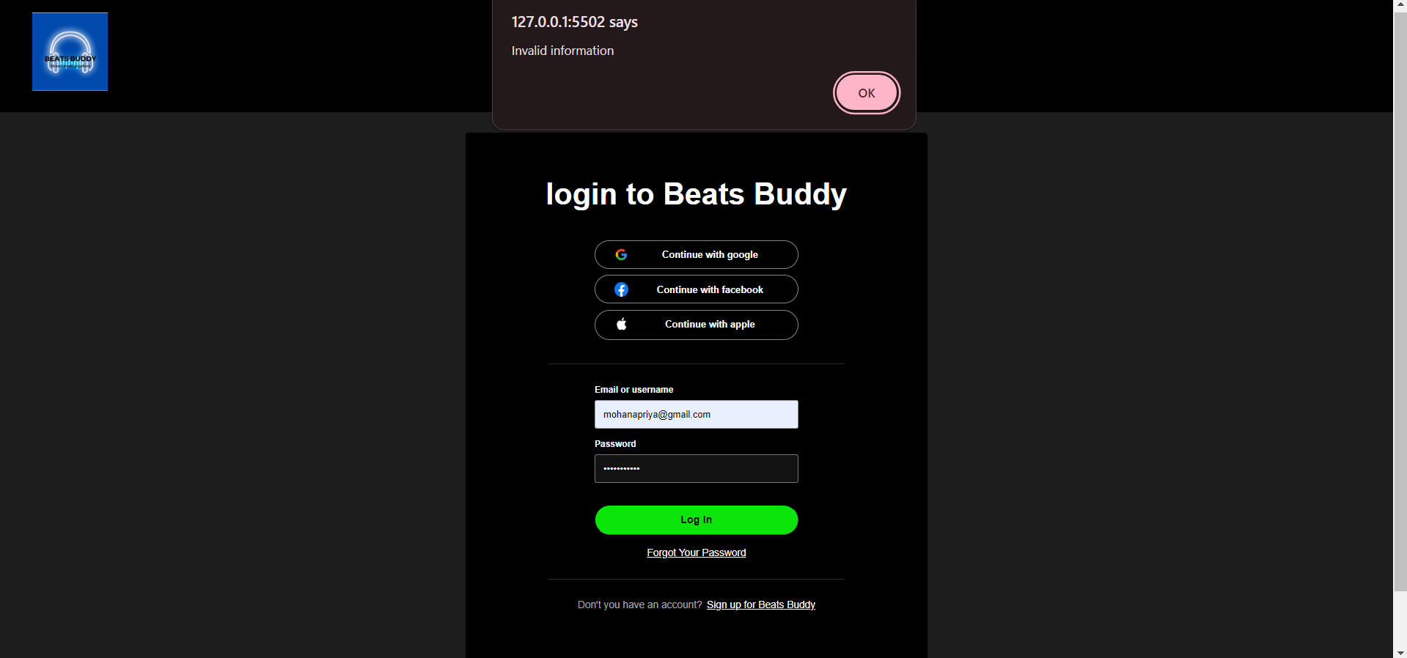

Slide 14
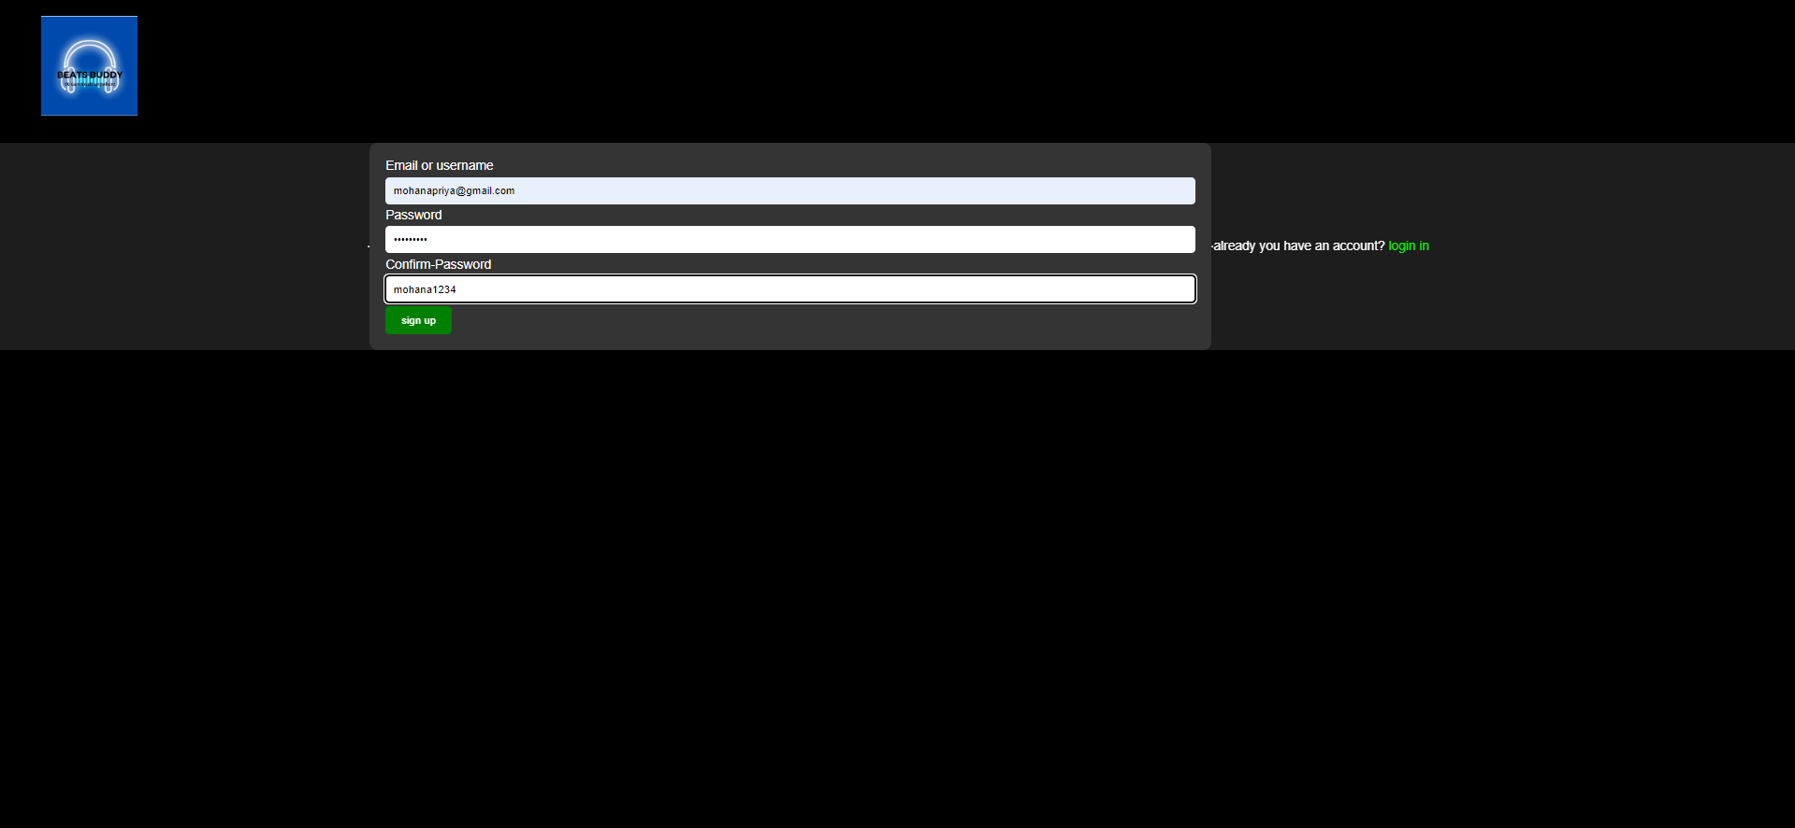
SIGNUP PAGE

Slide 15

HOME PAGE

Slide 16
Future Enhancements:
There are several potential future enhancements for the MusicHub application to improve its functionality and user experience. Some of these enhancements include:
Personalized Recommendations
Social Integration
User-Generated Content
Offline Mode
Lyrics Integration
Concert Information
Improved Search
Integration with Music APIs
Podcasts and Audiobooks
User Analytics
Implementing these enhancements would require additional development effort but would significantly enhance the Music application's functionality and appeal to users.
Source : https://www.cleveroad.com/blog/howto-create-a-music-streaming-app
https://www.resourceumc.org/en/cont
ent/5-steps-to-building-and-managinga-digital-music-library

Slide 17
Conclusion
In conclusion, the Music application named Beats Buddy project presents an exciting opportunity to create a robust and user-friendly music streaming application using the Django framework. By leveraging Django's features such as authentication, ORM, and RESTful APIs, we can develop a platform that allows users to discover, listen to, and manage their favorite music tracks seamlessly.
The proposed solution outlines key components and functionalities of the application, including user authentication, music library, playlist management, social features, audio streaming, responsive design, and API development. These components aim to provide users with a comprehensive music streaming experience while showcasing the capabilities of the Django framework in web development.
Future enhancements such as personalized recommendations, social integration, user-generated content, and offline mode can further improve the application's functionality and user engagement. Overall, Music application has the potential to become a popular music streaming platform, offering users a unique and enjoyable way to explore and enjoy music online.
Source : https://www.cleveroad.com/blog/howto-create-a-music-streaming-app
https://www.resourceumc.org/en/cont
ent/5-steps-to-building-and-managinga-digital-music-library

Slide 18
Thank You!
Notes:
Thank You !!

